Slide 1

Log File Analyzer
Log file analyzer is a powerful tool for understanding system behavior, debugging issues, and monitoring performance. This presentation will explore its design, features, and implementation.
RP
by RUSHIKESH PATIL

Slide 2
Problem Statement:
Problem Statement. :
: To address the given problem Statement Log File Analyzer POC, we will create a simple system using object-oriented programming and data structure's. The system will perform CRUD operations On log entries Analyze the specific
Log files For error massages and warnings And produces the summarises of the exstracted Information…

Slide 3
Real-Life Scenario Example:
Imagine a company called CloudCorp that runs an online cloud storage service. Their servers generate large log files every day, capturing every event that occurs, such as user actions, system processes, and errors.When users report performance issues with the service, the CloudCorp IT team uses the Log File Analyzer to scan the log files.The tool extracts all warnings and error messages related to server load and disk usage, providing a quick insight into potential server performance problems.Based on the log analysis, the team finds that one server has been repeatedly experiencing disk space issues, causing system slowdowns. The tool provides a summary, showing that this issue has occurred 50 times in the past week.By using the Log File Analyzer, CloudCorp can quickly diagnose issues based on historica data, prevent future problems, and maintain smooth service for their users.

Slide 4
System Design
Input Module
Processing Module
Output Module
Reads log files in various formats, such as plain text, JSON, or XML.
Analyzes log data to identify patterns, trends, and anomalies.
Generates reports and visualizations to present insights in a user-friendly manner.
Parses log entries to extract relevant data points, such as timestamps, events, and error messages.
Performs statistical calculations, such as frequency counts, averages, and standard deviations.
Supports various output formats, such as text files, graphs, or dashboards.

Slide 5
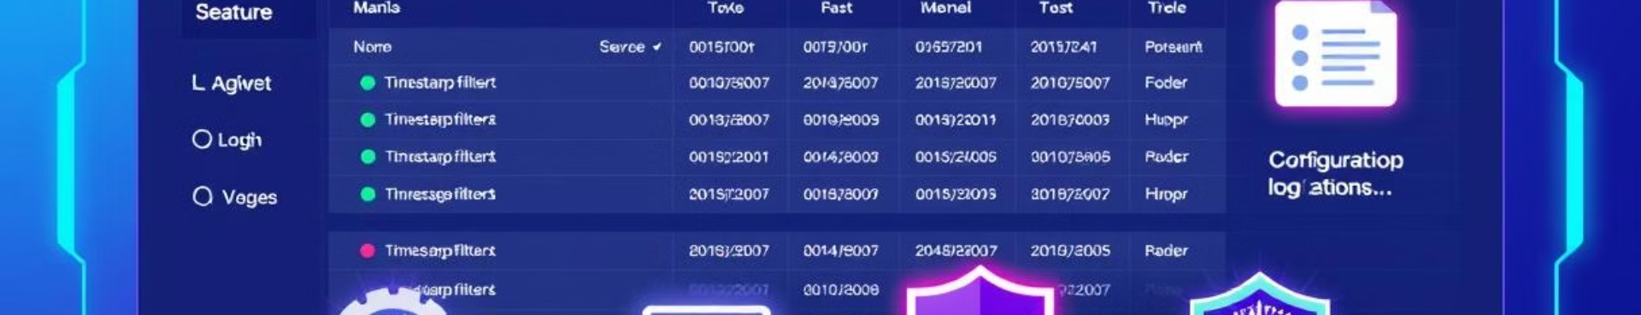
Core Features
1
Create
2
Read
Allows users to create new log analysis projects and configure settings.
Imports log files from various sources, including local files or remote servers.
3
Update
4
Delete
Provides options to modify analysis parameters, such as filtering criteria or aggregation methods.
Enables users to remove projects, log files, or analysis results as needed.

Slide 6

Supported Log File Formats
Plain Text
JSON
XML
CSV
Syslog
Apache Access Logs

Slide 7

Technology Stack
Python
Pandas
Programming language for core functionality.
Library for data manipulation and analysis.
Matplotlib
unittest
Library for creating visualizations.
Framework for testing code quality.

Slide 8
Implementation Process
Requirements Gathering
1
Defining user needs and system functionalities.
2
Design & Architecture
Creating system blueprints and class structures.
Implementation
3
Writing code modules and integrating components.
4
Testing & Debugging
Validating functionality and resolving issues.
Deployment
5
Making the system accessible to users.

Slide 9
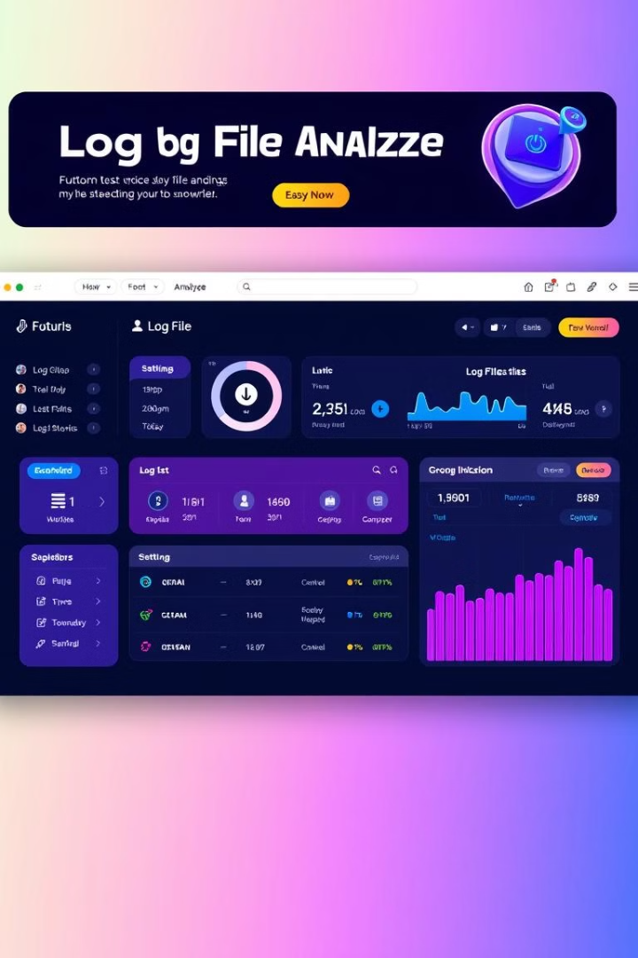
User Interface (If Any)
The user interface provides an intuitive way to manage log analysis projects, upload and analyze log files, and view results in various formats. Users can easily navigate between different sections, configure analysis parameters, and export data or visualizations as needed. The design emphasizes clear and concise information display, facilitating user understanding and interaction.

Slide 10




Challenges and Solutions
Performance Optimization
Challenges: Handling large datasets, efficient data processing.
Data Consistency
Challenges: Dealing with inconsistent log formats, missing data, or errors.
User Interface Design
Challenges: Creating a user-friendly and intuitive interface for complex functionalities.

Slide 11




Future Scope
Machine Learning
Integration of machine learning algorithms for anomaly detection and predictive analysis.
Cloud Integration
Deployment on cloud platforms for scalability and accessibility.
Automated Reporting
Generation of customizable reports and alerts based on defined criteria.

Slide 12

Conclusion and Next Steps
The Log File Analyzer is a valuable tool for understanding and analyzing log data. By leveraging its features, users can gain insights into system behavior, troubleshoot issues, and improve performance. Future development efforts can focus on enhancing its capabilities through machine learning integration, cloud deployment, and automated reporting functionalities.

Slide 13


